Slide 1
10GB BATS Parser with Security Filter Proof of Concept https://fpganow.com

Slide 2
Overview
High Level Systems Diagram
Programmable Layer (PL)
Processing System (PS)
LabVIEW FPGA
BATS Parser
C++ bare-metal
PCS/
PMA
MAC
UDP/IP
Filter
FIFOs
FIFOs
FIFOs
PetaLinux
Other IP
IP1
IP1

Slide 3
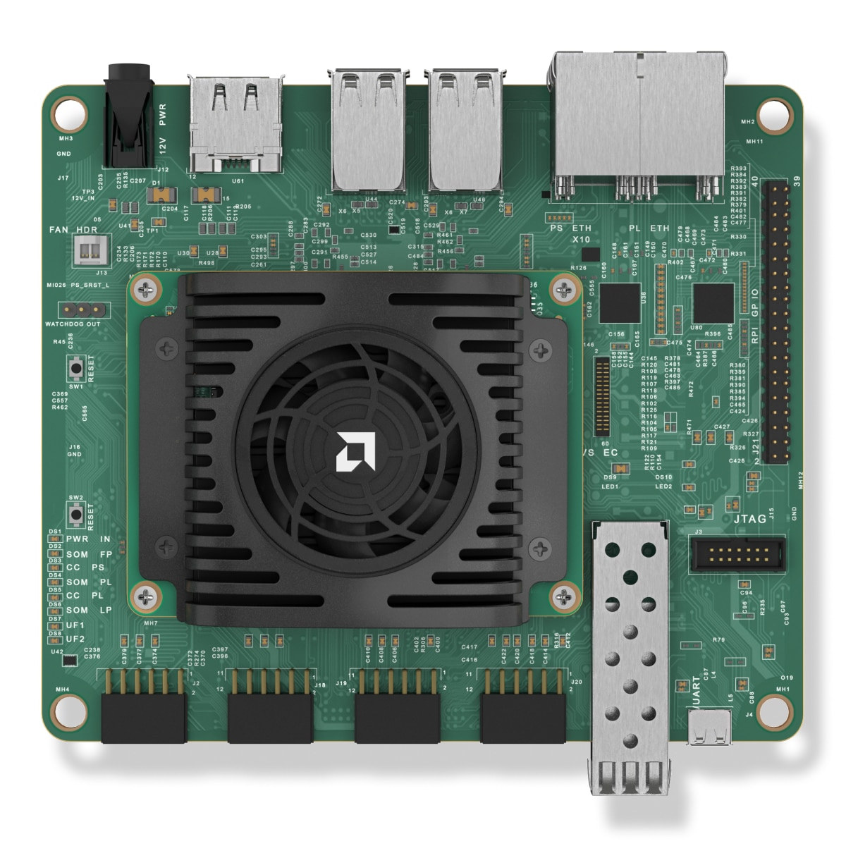
Hardware
Kria KR260 Robotics Starter Kit
Cheap: $349.00
https://www.amd.com/en/products/system-on-modules/kria/k26/kr260-robotics-starter-kit.html
1 SFP+ Connector (10 Gigabit )

Slide 4
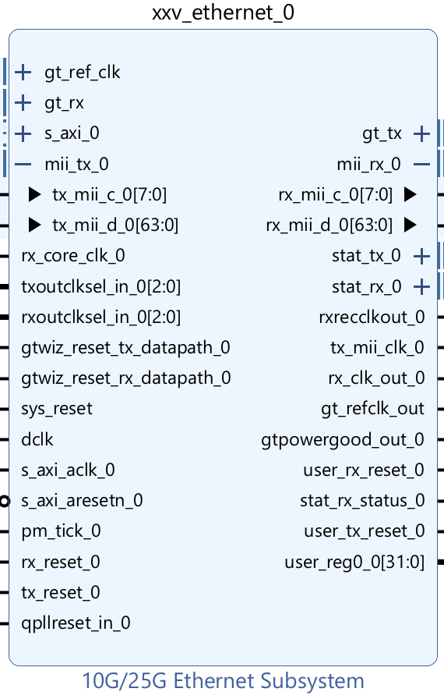
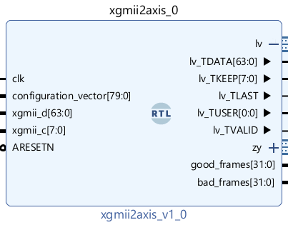
Network Connectivity
Vivado Block Design
LabVIEW FPGA IP
MAC
PCS/PMA

Slide 5
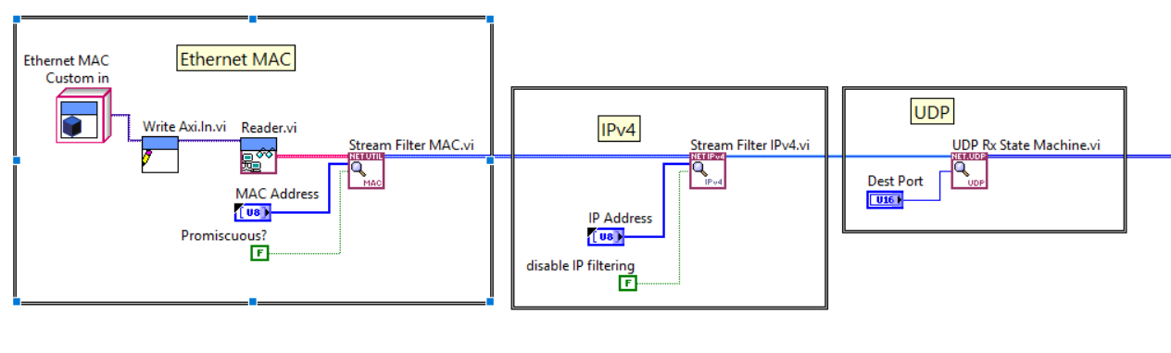
UDP / IP Stack
LabVIEW FPGA

Slide 6
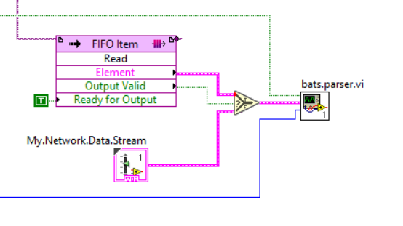
BATS Parser and Normalizer
Parses UDP Network Data Stream

Slide 7
Security Filter

Slide 8
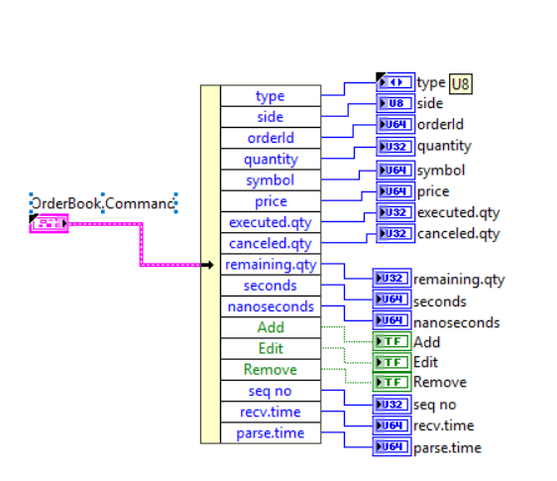
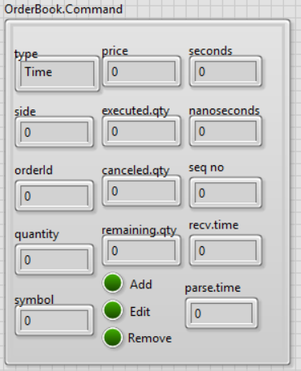
Normalized Messages
LabVIEW FPGA Cluster Format

